Slide 1
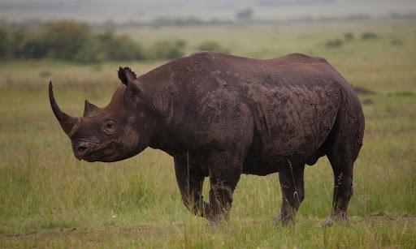
Black Rhinoceros
Mishal, Deepa, Dillon, Tarsus, and Sai
Group 3

Slide 2
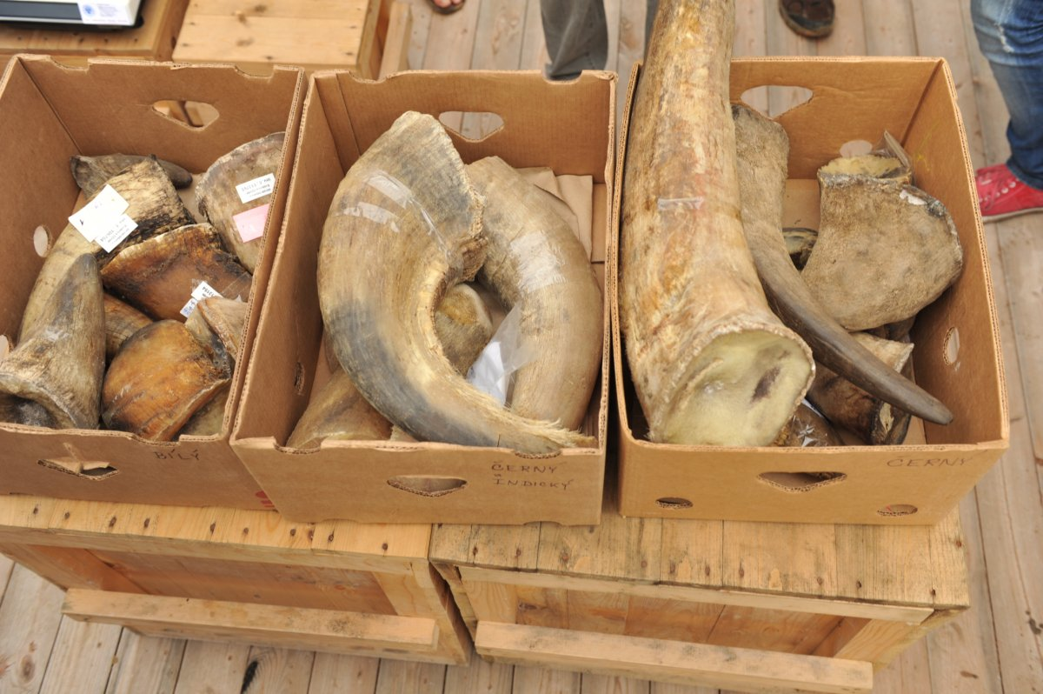
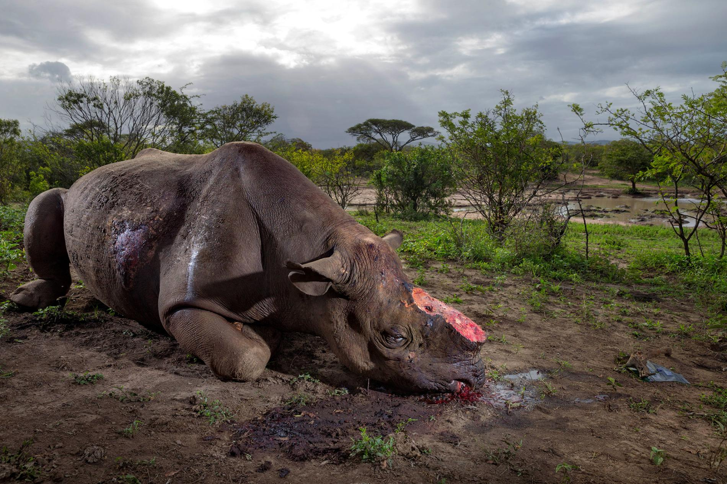
Introduction
Black rhinoceros are on the verge of extinction due to poaching
Limited data on genetic variation and evolutionary history
Only 31% of haplotypes were found in extant populations
Data can help create effective recovery and conservation plans

Slide 3
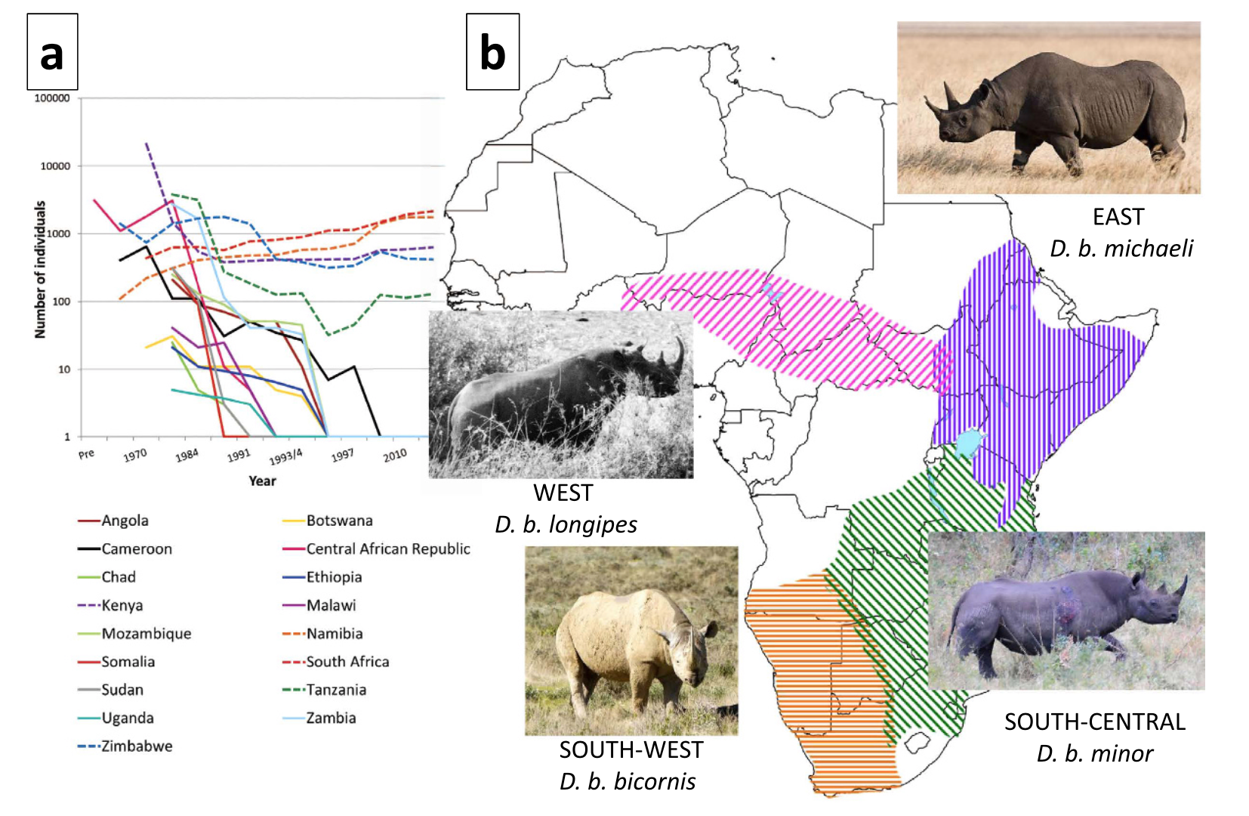
Historical Range
Paper: Extinctions, genetic erosion and conservation options for the black rhinoceros (Diceros bicornis)
Notes:
Historical range. 4 subspecies.
Currently, only found in 5 countries. Massive decline in numbers
Conservation. How data applies

Slide 4
Important Terms
Genetic erosion: certain loci wiped out as reproductive individuals die
Genetic drift: change in frequency of genotypes
Locally extinct: all haplotypes are detected in extant (existing) populations
Globally extinct: none of its historical haplotypes are sampled among extant populations

Slide 5
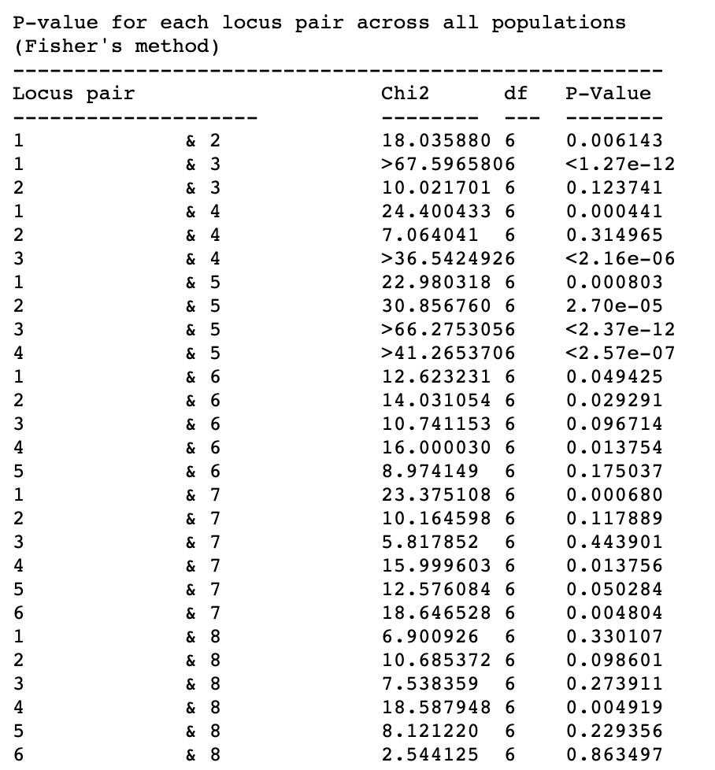
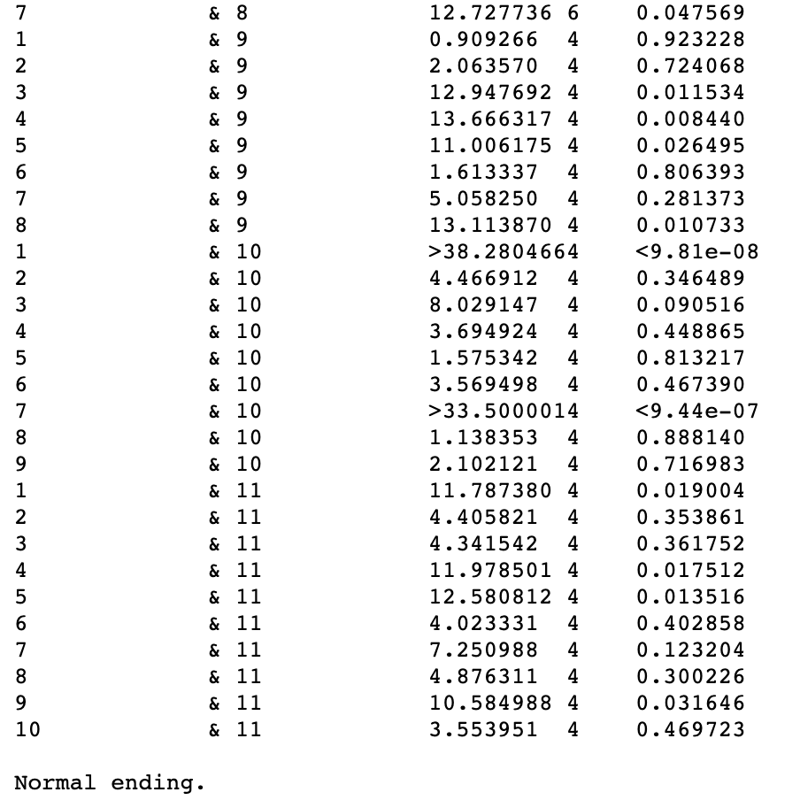
Genepop: Linkage Disequilibrium

Slide 6
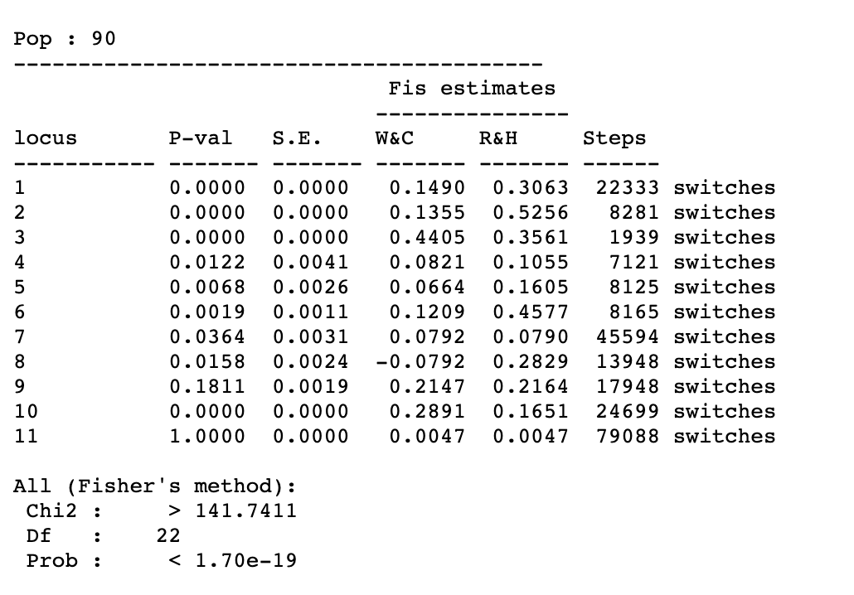
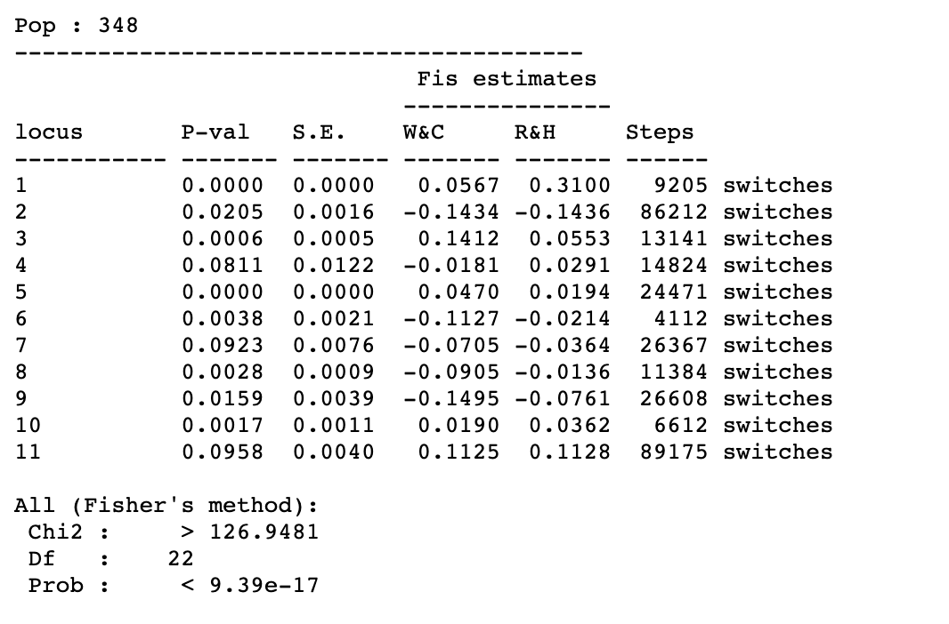
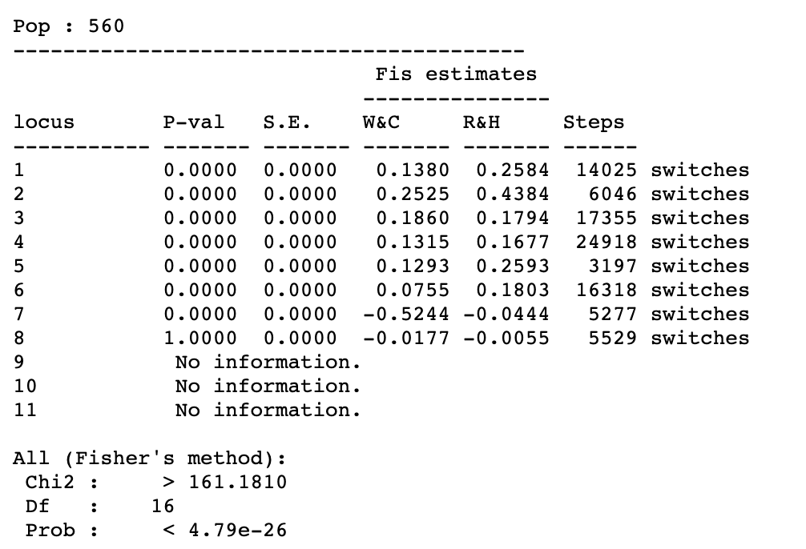
Genepop: Hardy-Weinberg

Slide 7
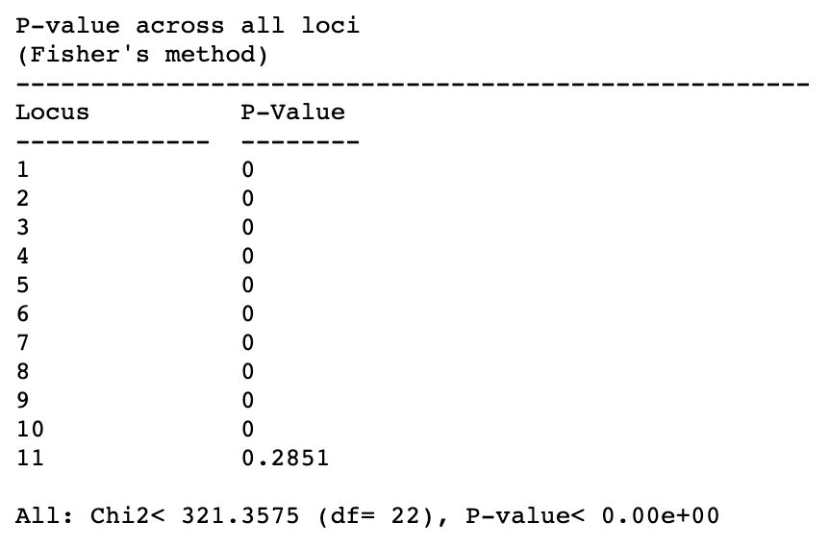
Genepop: Genetic Differentiation

Slide 8
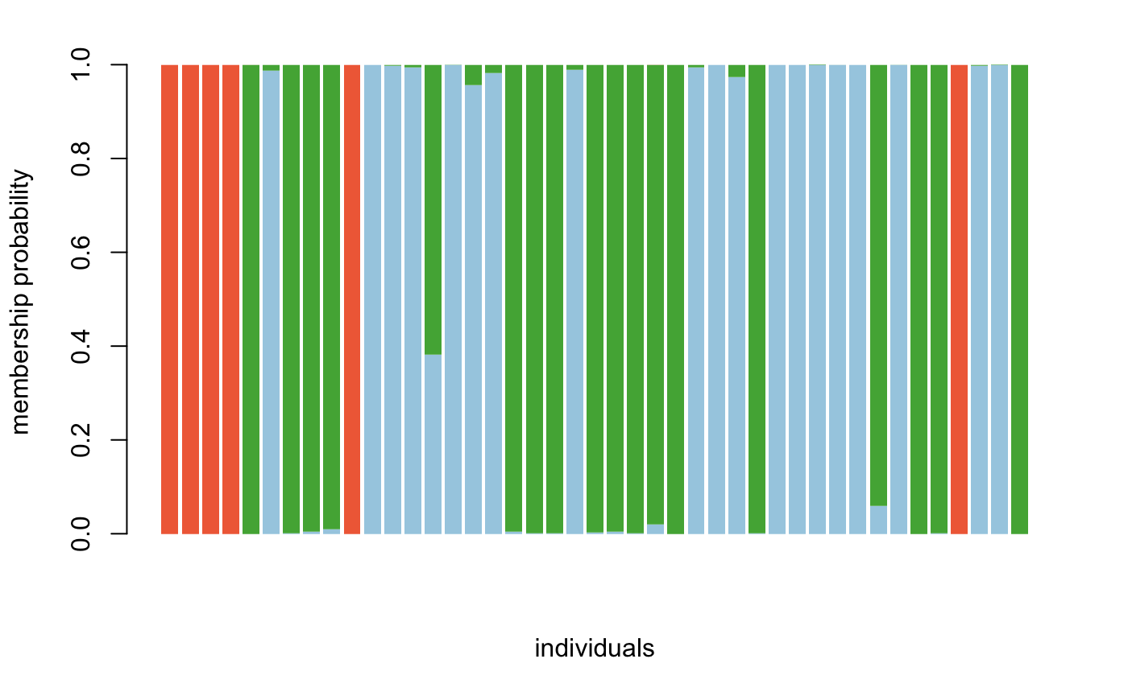
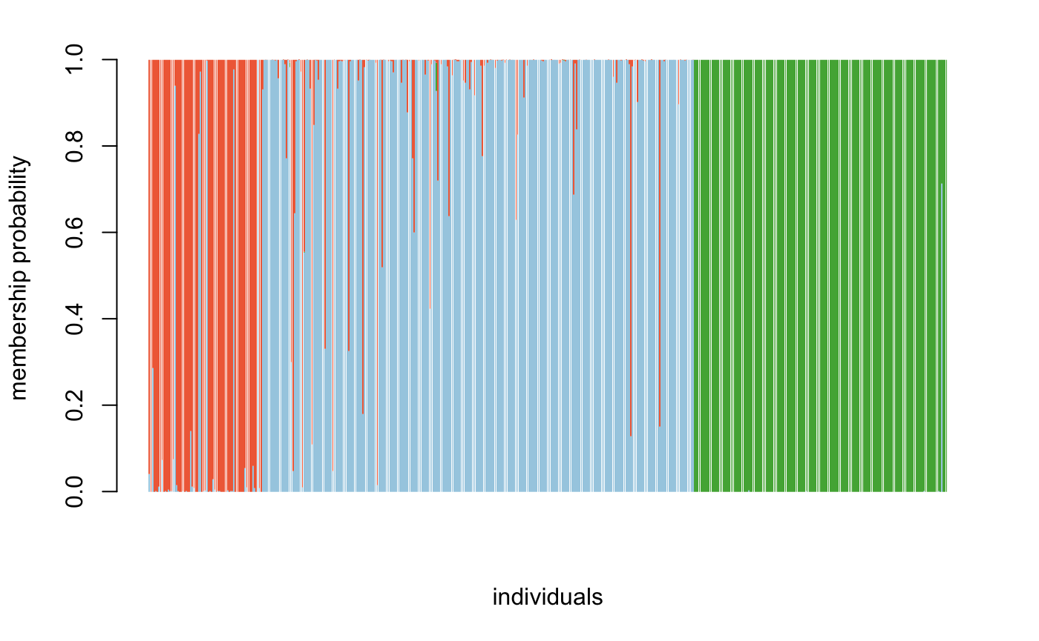
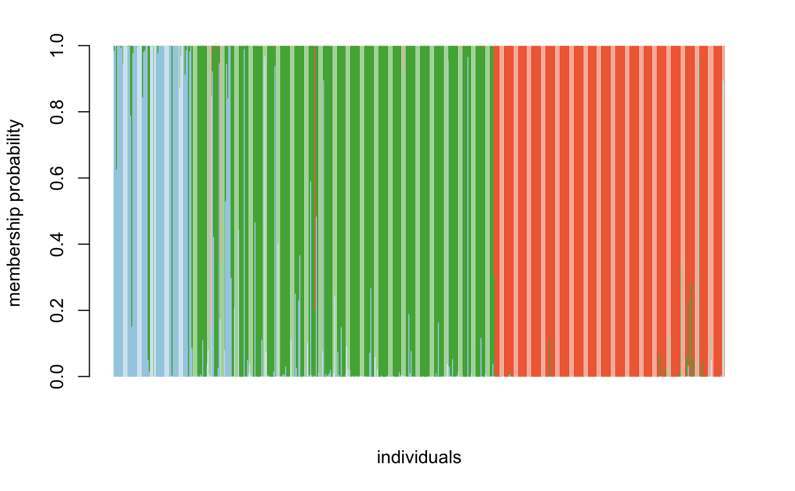
Extinct
Extant
Total

Slide 9
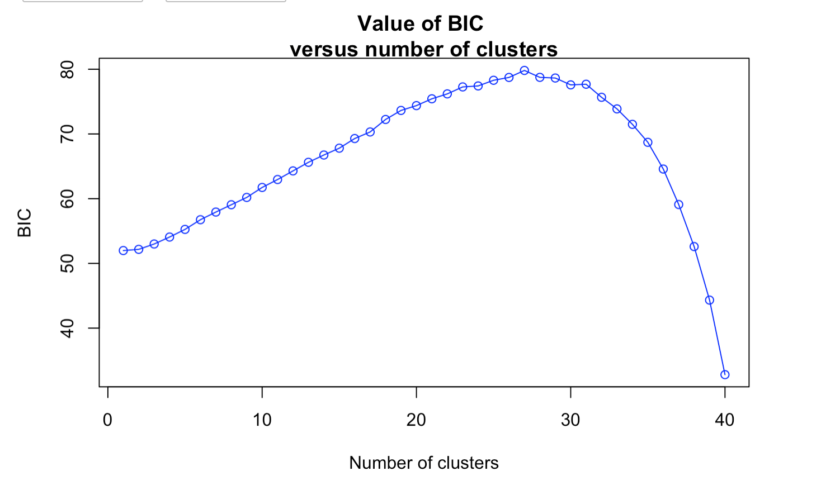
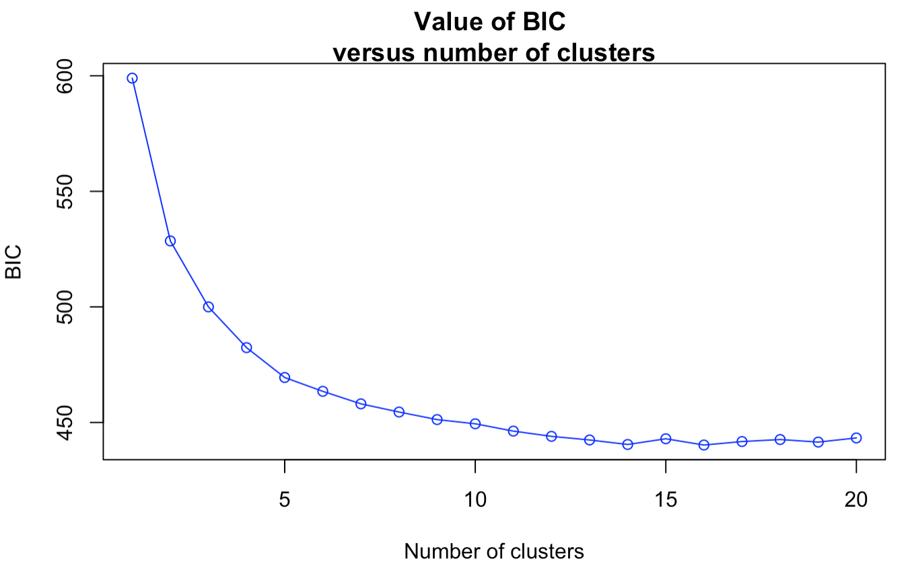
Extant
Extinct

Slide 10
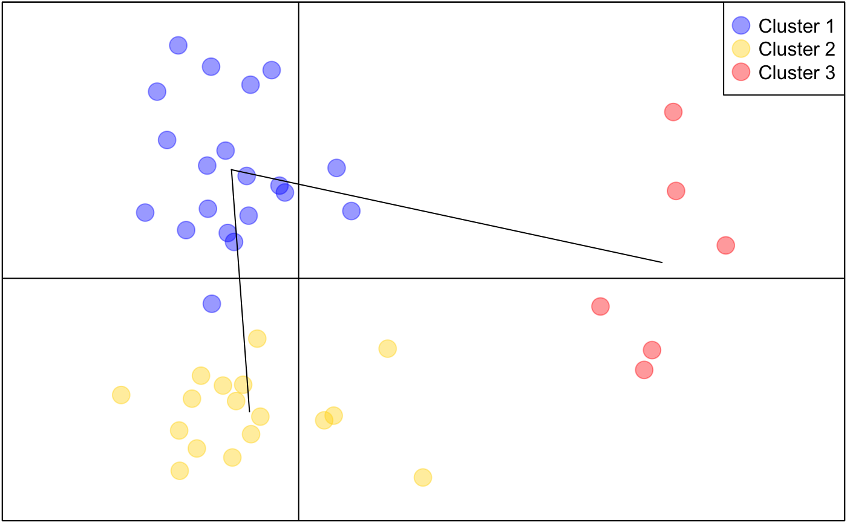
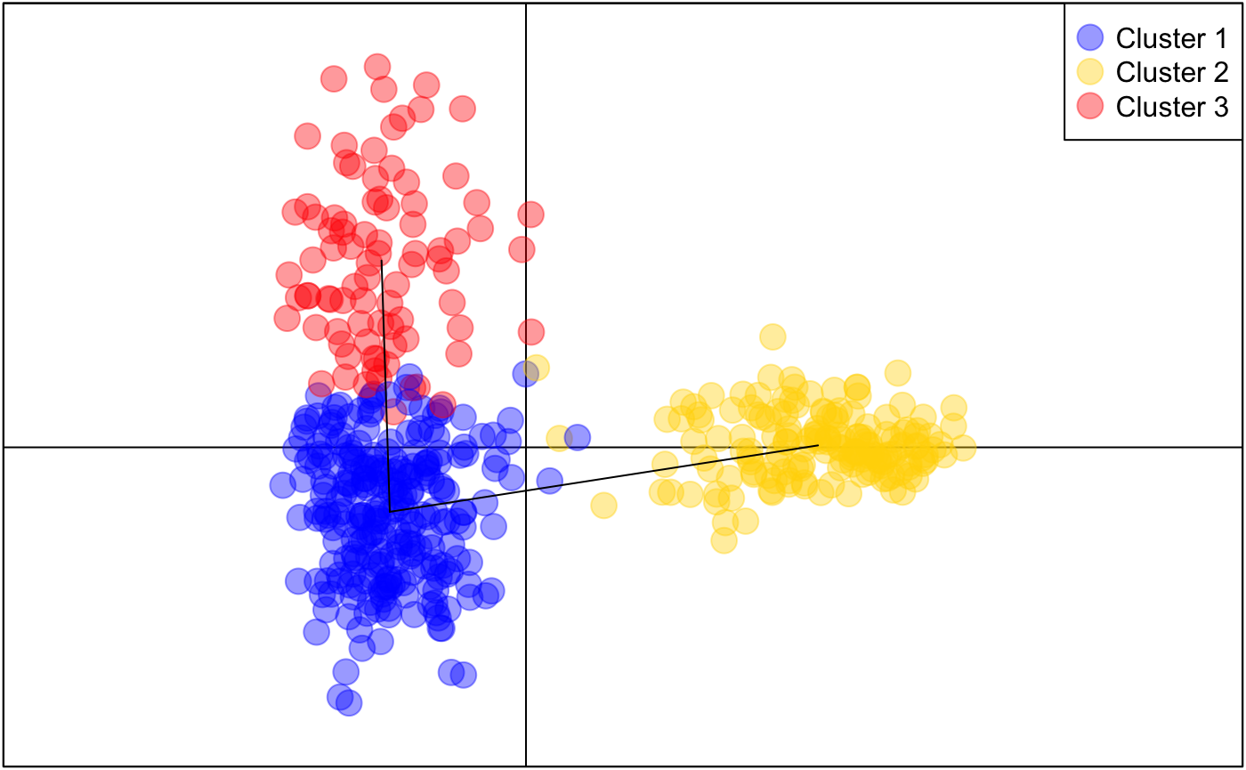
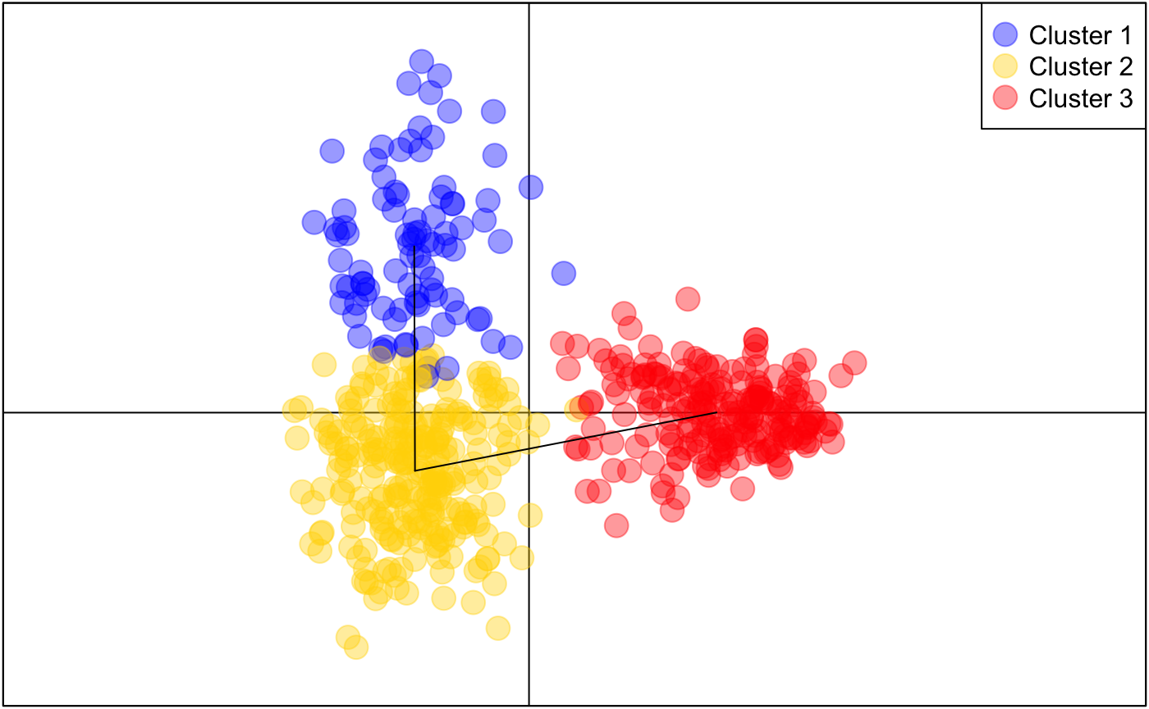
Extinct
Extant
Total

Slide 11
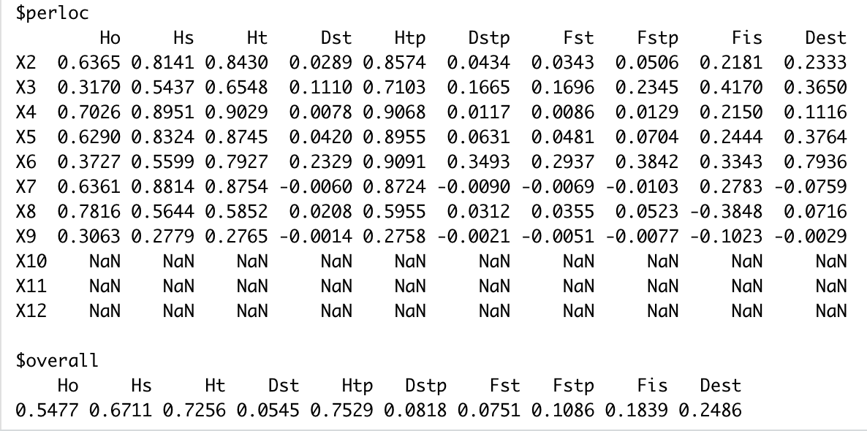
Extinct
Notes:
extinct

Slide 12
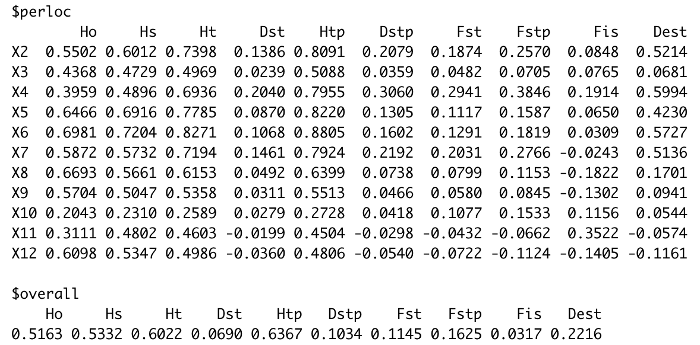
Extant
Notes:
extant

Slide 13
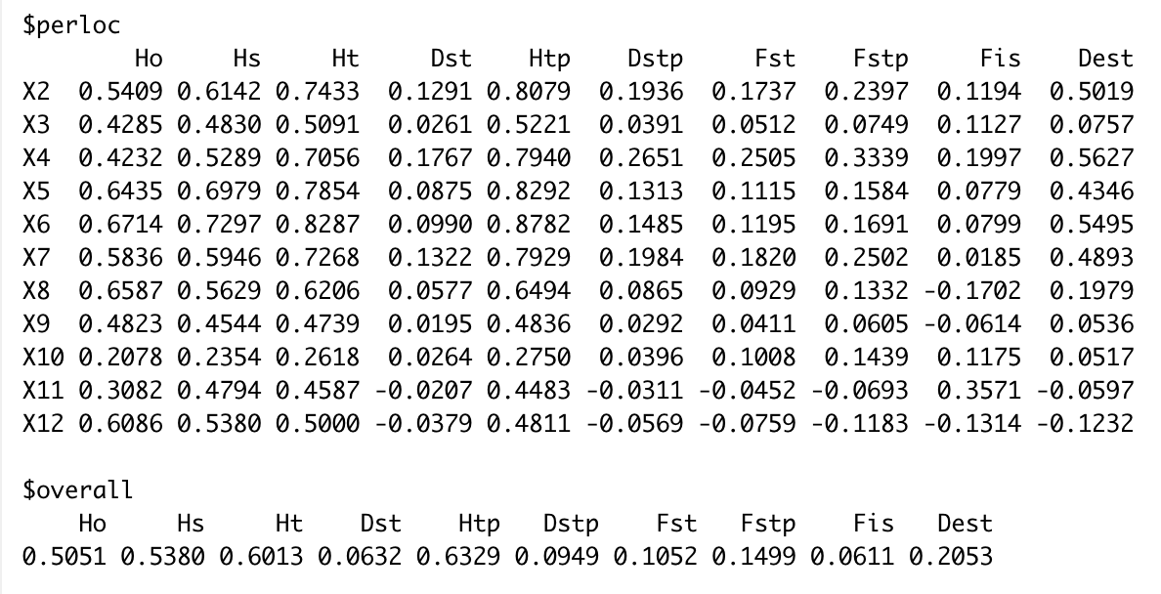
Total
Notes:
total

Slide 14
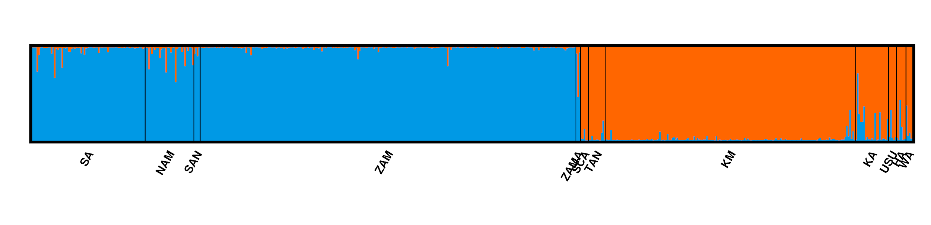
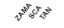
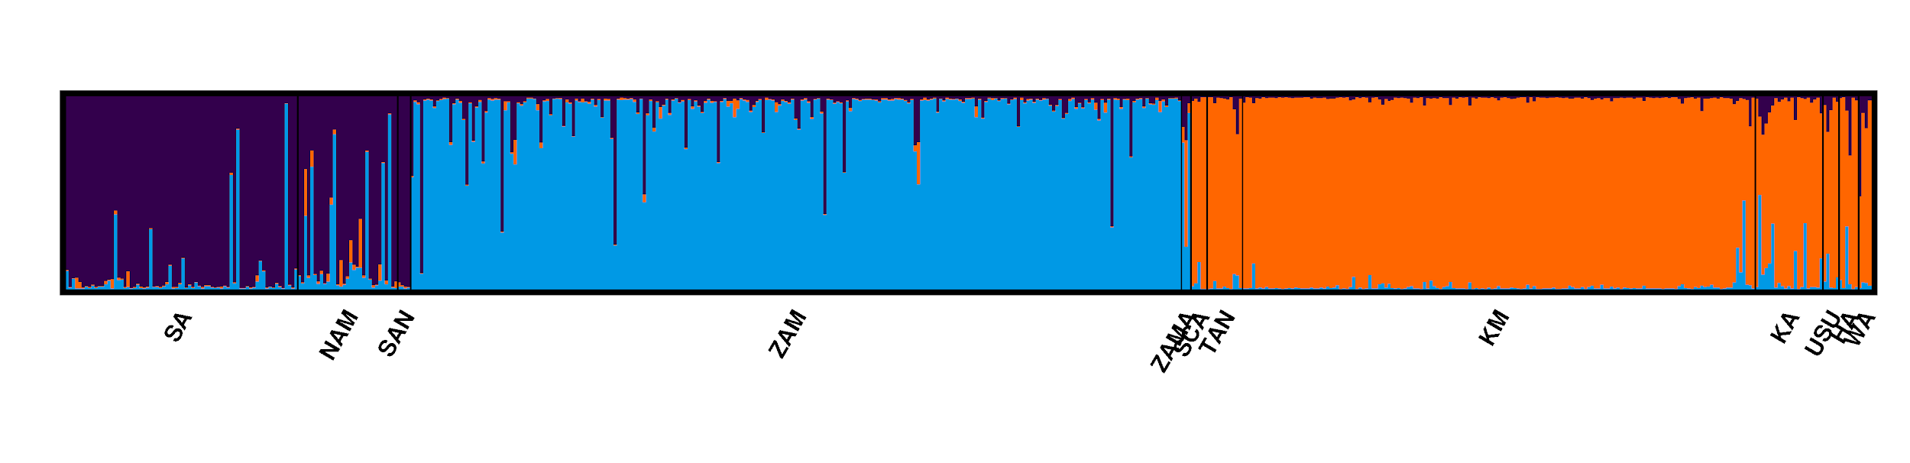
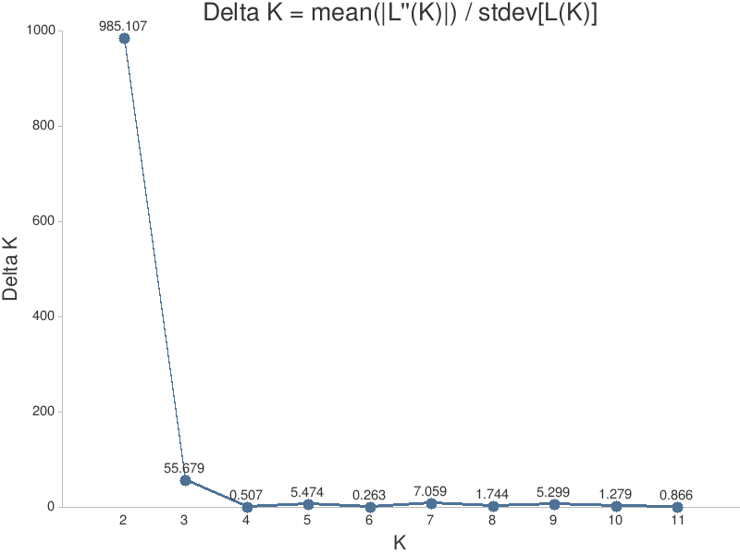
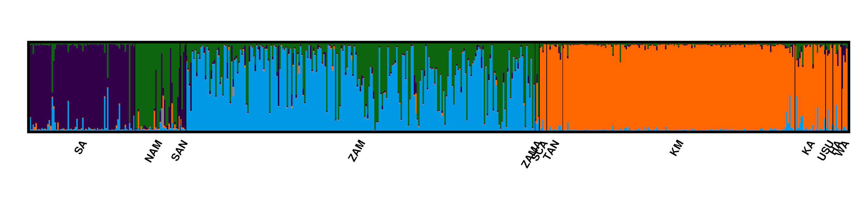
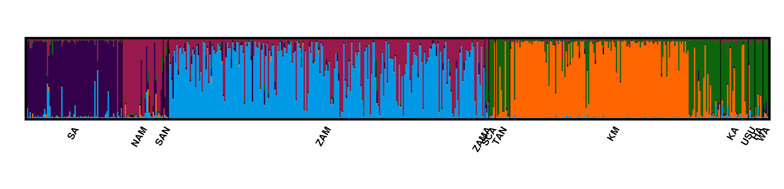
Structure:
K=2
ZAMA
SCA
TAN
K=3
K=4
K=5
Range-wide nuclear genetic structure of the black rhinoceros using microsatellite data:
Notes:
View your job's results here:http://clumpak.tau.ac.il/results.html?jobId=1606186838

Slide 15
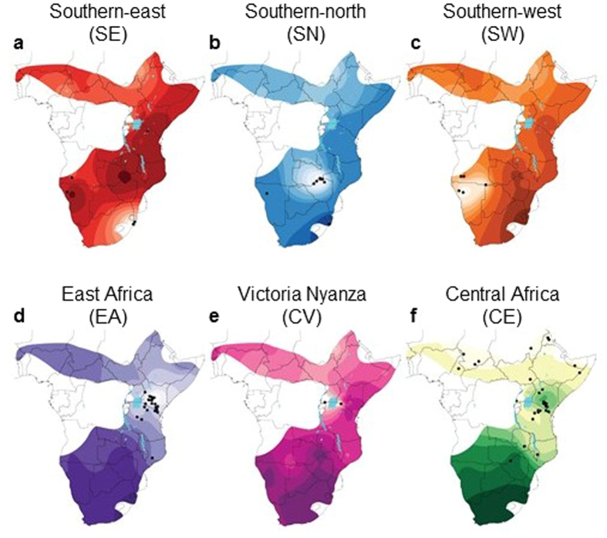
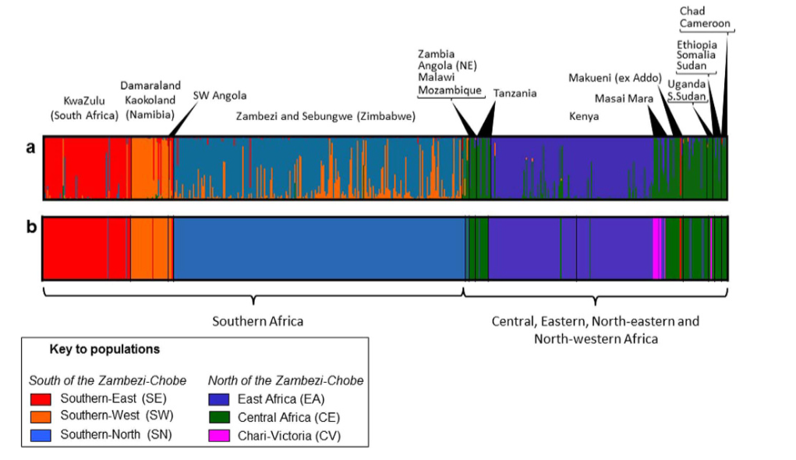
K = 5
South Africa Namibia Zambezi Zambia(ancient) Kenya Uganda-Sudan
South Angola South Central Africa Horn of Africa
Tanzania West Africa
Note: One of the populations (Victoria Nyanza) is not included in this data
Notes:
5 biologically meaningful populations
Cluster I was predominantly found at sites within South Africa and showed the least evidence of admixture
Cluster II comprised individuals from Namibia
Cluster III comprised individuals from Zimbabwe
A fourth, East African group, mainly comprised individuals from Kenya
Fifth: widespread Central African cluster included samples from countries north of the Zambezi-Cuando/Chobe system
They* carried out five repetitions for each value of K between 1 and 10, allowing for individuals with mixed ancestry (admixture model) and with each run comprising two million MCMC (Markov chain Monte Carlo) iterations.

Slide 16
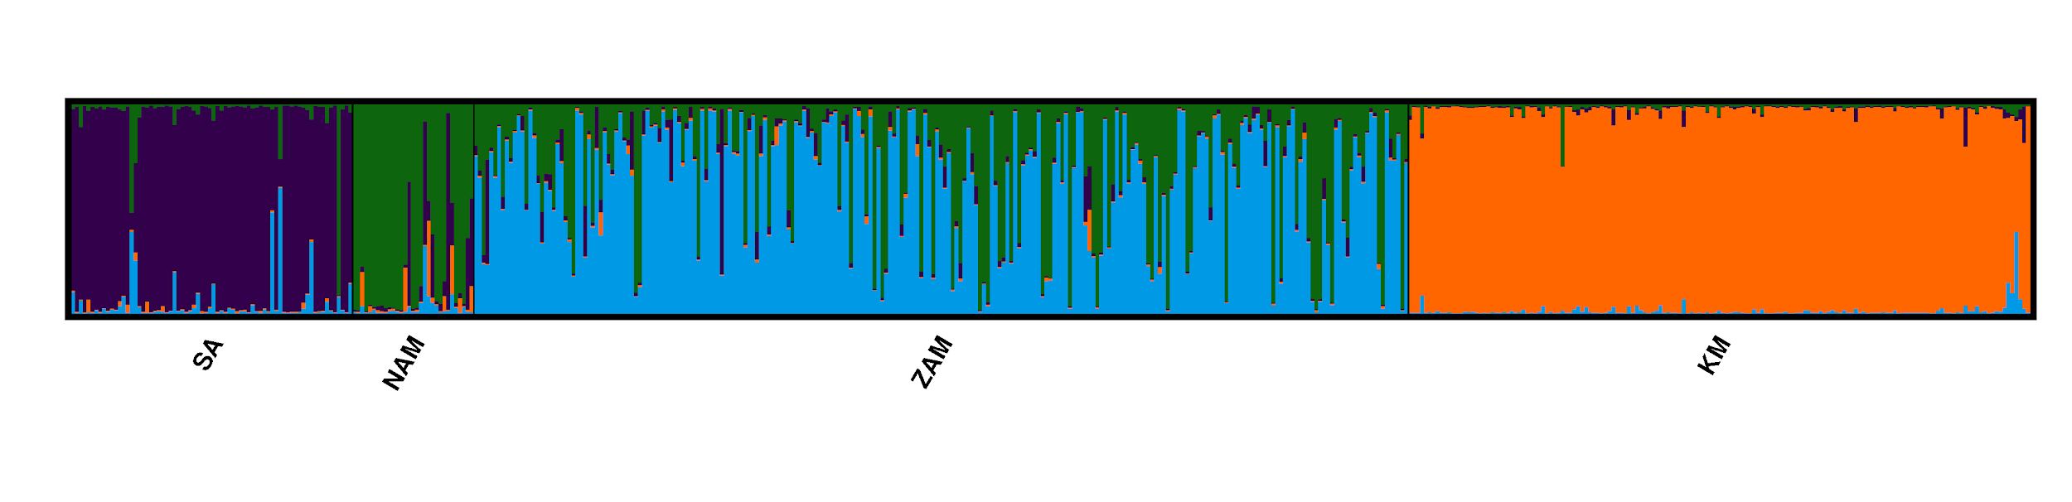
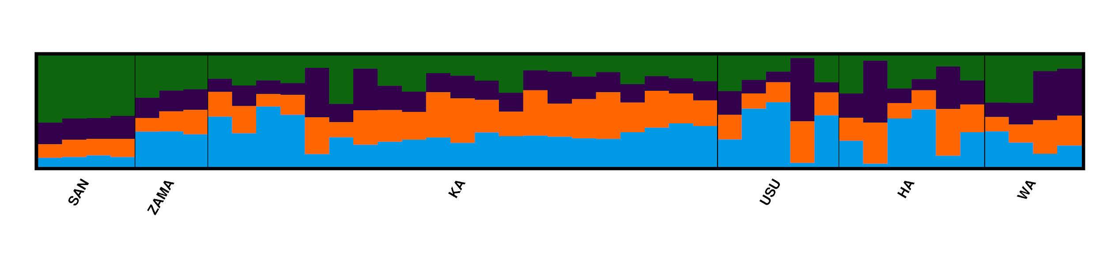
Extinct vs. Extant (K=4)
Extant:
*Note: We had to take out Tanzania from extant population because it was not clear which of the individuals were extinct vs. extant.
Extinct:
*Note: The data might not have been enough to have an accurate analyses
Notes:
http://clumpak.tau.ac.il/results.html?jobId=1606189256

Slide 17
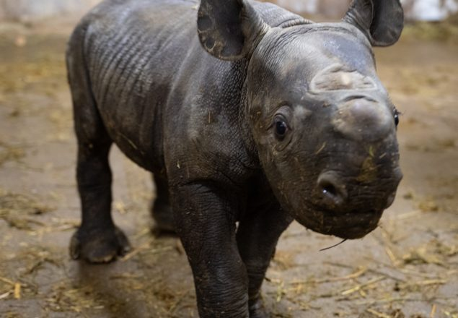
Conclusion
Mitochondrial and microsatellite data reveals human impact on genetic diversity
Black rhinos exists in only 5 countries with only 5 biologically distinct populations
South Africa, Zimbabwe, Namibia, Tanzania, Kenya
Extant clusters by geography but extinct genetically not similar within populations
Even if poaching stops, there still exists danger of genetic erosion
Misguided translocation of individual rhinos can result into genetic erosion of an already small genetically diverse population
This paper can guide conservation efforts in the future so that genetic erosion does not take place.

